Slide 1

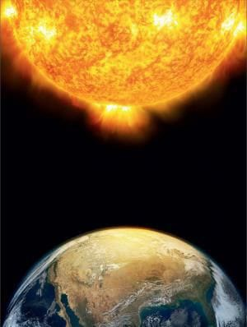
SAVEETHA SCHOOL OF ENGINEERING CSA0827-Python programming in numerical computations PREDICTING SOLAR RADIATION LEVELS
GUIDE NAME:
Raveena Selvanarayanan
Presented by :
Bhanu Sree (192211029)​
V.Sumanth (192111465)​
G.Mathen Kumar(192011149)

Slide 2
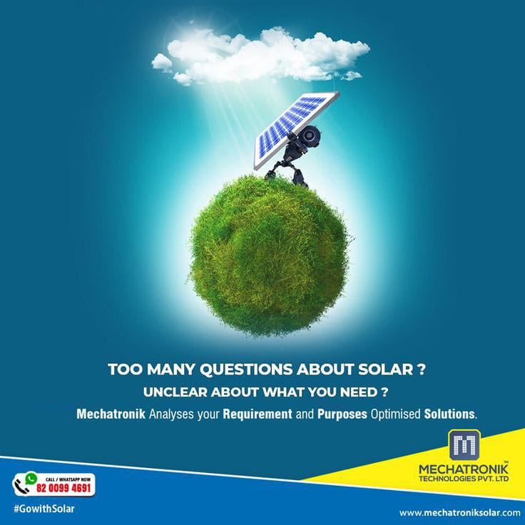
ABSTRACT:
Solar radiation is a fundamental energy source that plays a crucial role in various natural and human activities. Understanding its levels is essential for optimizing solar energy utilization, climate modeling, agriculture, and environmental monitoring. This abstract provides a concise overview of the methodologies and factors influencing solar radiation levels, drawing insights from recent research. The assessment of solar radiation levels involves measuring incoming solar radiation at the Earth's surface and understanding the factors affecting its intensity, such as geographical location, time of day, season, atmospheric conditions, and surface albedo. Various instruments, including pyranometers, pyrheliometers, and radiometers, are employed to measure different components of solar radiation accurately.

Slide 3
Geographical location significantly influences solar radiation levels, with equatorial regions generally receiving higher levels of solar irradiance than polar regions. Additionally, factors such as cloud cover, atmospheric pollution, and aerosols can attenuate solar radiation, affecting its intensity at the surface. The seasonal variations in solar radiation levels are mainly attributed to the tilt of the Earth's axis and its orbit around the Sun. Accurate assessment of solar radiation levels is vital for the design and optimization of solar energy systems, including photovoltaic and solar thermal technologies. Furthermore, understanding spatial and temporal variations in solar radiation facilitates better crop management in agriculture, prediction of weather patterns, and assessment of climate change impacts. This abstract highlights the importance of assessing solar radiation levels for various applications and provides insights into the methodologies and factors influencing solar irradiance at the Earth's surface. Further research in this area is essential for advancing renewable energy technologies and addressing challenges related to climate change and sustainable development.

Slide 4
INTRODUCTION:
Solar radiation prediction plays a pivotal role in numerous fields, including renewable energy generation, urban planning, agriculture, and climate modeling. Accurate forecasting of solar radiation levels is essential for optimizing the efficiency of solar energy systems, managing agricultural practices, and understanding climate variability and change. This introduction provides an overview of the methods and applications of solar radiation prediction, highlighting the significance of this endeavor in addressing energy and environmental challenges.The introduction begins by outlining the importance of solar radiation as a primary energy source and its increasing role in the global energy mix. Solar energy technologies, such as photovoltaic and concentrating solar power systems, rely on the availability of solar radiation for electricity generation. Therefore, accurate prediction of solar radiation levels is crucial for maximizing energy production and ensuring the economic viability of solar power projects. Next, the introduction discusses the various methods used for predicting solar radiation levels, ranging from empirical models to physical and numerical modeling approaches.

Slide 5

Empirical models utilize historical solar radiation data and meteorological parameters to forecast future irradiance levels, while physical models consider the underlying processes governing the interaction of solar radiation with the atmosphere and Earth's surface. Numerical weather prediction models leverage computational simulations to provide spatially and temporally resolved predictions of solar radiation under different atmospheric conditions.The introduction also highlights the diverse applications of solar radiation prediction across different sectors. In the field of renewable energy, accurate forecasts of solar radiation enable optimal planning and operation of solar power plants, grid integration, and energy trading. In agriculture, solar radiation prediction aids in crop growth modeling, irrigation scheduling, and optimizing resource allocation for enhanced productivity. Furthermore, solar radiation forecasts contribute to climate modeling efforts by improving our understanding of energy balance dynamics and feedback mechanisms in the Earth's atmosphere and surface.

Slide 6
AUTHOR NAME | CONCEPT | ADVANTAGES | FUTURE SCOPE | ALGORITHM
Yuanjian Yang | The concept of predicting solar radiation levels involves using empirical, physical, or numerical models to forecast the amount of sunlight reaching the Earth's surface. | Optimizing Solar Energy Systems: Accurate forecasts enable the efficient design, operation, and maintenance of solar power plants and photovoltaic arrays, maximizing energy production and economic viability. | The future scope of predicting solar radiation levels lies in advancing predictive accuracy through the integration of machine learning algorithms and satellite data, enabling real-time monitoring and forecasting. | Gather historical data and clean data by misleading values. Design systems that can adapt variations in solar radiation. Integrate machine learning based solar predictions with weather forecasting.

Slide 7
AUTHOR NAME | CONCEPT | ADVANTAGES | FUTURE SCOPE | ALGORITHM
Yuanjian Yang | By considering factors such as geographical location, atmospheric conditions, and surface characteristics, these predictions are vital for optimizing solar energy systems, urban planning, agriculture, and climate modeling. | It facilitates efficient agricultural practices, supports climate modeling for enhanced understanding of climate variability, and informs energy trading and resource planning decisions, fostering a transition towards renewable energy and environmental conservation. | Additionally, innovations in sensor technology and data assimilation techniques will enhance spatial and temporal resolution, supporting diverse applications such as precision agriculture, autonomous energy systems, and climate adaptation strategies, ultimately driving the widespread adoption of solar energy and fostering sustainable development globally. | Had constructed 12 machine learning models to predict and compare daily and monthly values of solar radiation and a stacking model using the best of these algorithms were developed to predict solar radiation. The main components are data preprocessing, model building and model prediction. This methodology uses monthly based dataset. For the algorithm respective statistics metrics reports, graphs are summarized.

Slide 8
Ground-Based Sensors(Existing system):
In weather stations and solar monitoring stations,this sensors are used to collect data for predicting solar radiation levels. The ground based instruments such as pyranometers are used to measure global radiation.
Solar Radiation Shields: These shields are used to protect sensors from external influences that could affect their accuracy, such as wind and precipitation. Shields are often used in conjunction with temperature and humidity sensors to provide more accurate solar radiation predictions.
Spectroradiometers: Spectroradiometers measure solar radiation across different wavelengths of the electromagnetic spectrum. This allows for a more detailed analysis of solar radiation.

Slide 9
HARDWARE AND SOFTWARE:
A pyranometer is a scientific instrument used to measure the total solar radiation received by a surface, typically expressed in watts per square meter (W/m²). It consists of a thermopile sensor that detects the heat generated by solar radiation and converts it into an electrical signal. Pyranometers are widely used in meteorology, climatology, renewable energy, and agriculture to monitor solar energy availability, optimize solar power generation, assess climate patterns, and inform agricultural practices. They play a crucial role in understanding the Earth's energy balance and climate system, contributing to various scientific and practical applications aimed at harnessing solar energy and mitigating climate change.

Slide 10
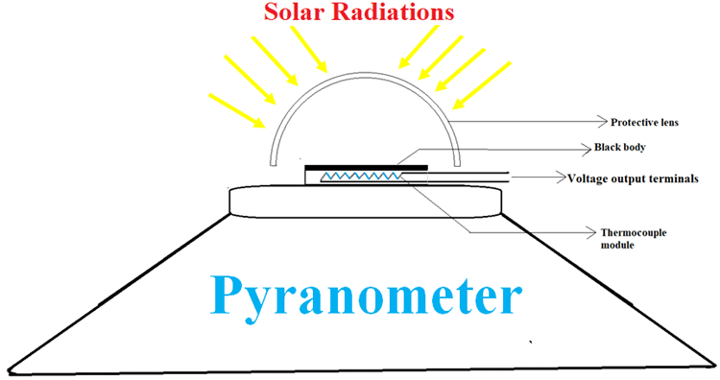
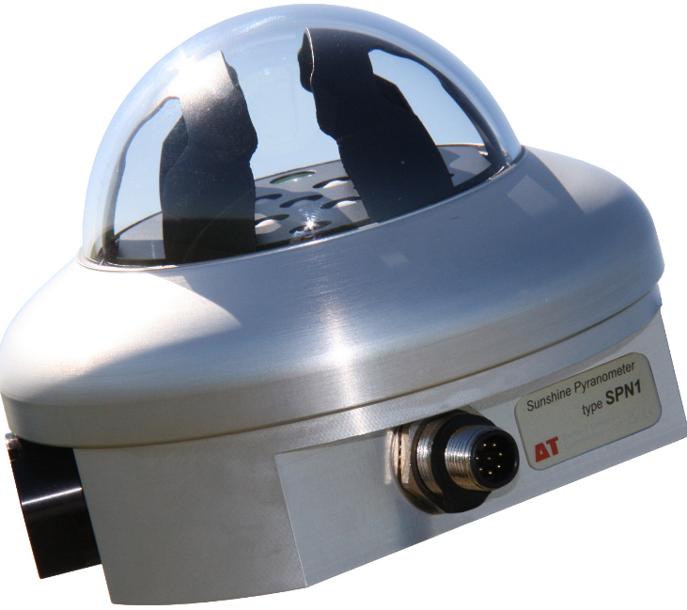
Pyranometer
Working:
Structure:

Slide 11
WORKING:
Thermopile Sensor: The heart of a pyranometer is a thermopile sensor, which is a device consisting of multiple thermocouples connected in series. Thermocouples are made of two dissimilar metals that generate a voltage when exposed to a temperature difference. In a pyranometer, one side of the thermopile is heated by solar radiation, while the other side remains at a reference temperature.
Solar Radiation Absorption: When sunlight strikes the surface of the pyranometer, a portion of the incoming solar radiation is absorbed by the blackened surface of the instrument. This absorbed radiation heats up the surface of the thermopile, creating a temperature difference between the two sides of the thermopile.
Generation of Voltage: The temperature difference between the two sides of the thermopile generates a voltage signal proportional to the incoming solar radiation intensity. This voltage signal is then amplified and converted into a standardized output, typically in millivolts (mV) or microvolts (μV) per unit of irradiance (W/m²).

Slide 12
4.Calibration: Before deployment, pyranometers undergo calibration procedures to establish a linear relationship between the output voltage and the incident solar radiation. This calibration ensures accurate measurement of solar radiation under various environmental conditions.
5.Data Recording: The output signal from the pyranometer is recorded by data acquisition systems, dataloggers, or data loggers, which store and process the information for further analysis. The recorded data can be used for a wide range of applications, including meteorology, climatology, solar energy resource assessment, and environmental monitoring

Slide 13
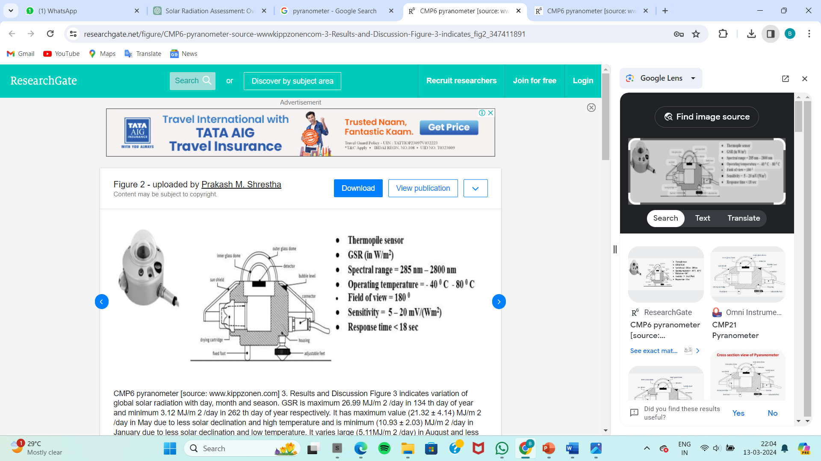

Slide 14
Meteorological Data Model(New system):
Variables Selection: Choose meteorological variables relevant to solar radiation prediction, such as temperature, humidity, cloud cover, atmospheric pressure, wind speed, and solar zenith angle.
Solar Radiation Parameters: Incorporate parameters including direct normal irradiance (DNI), diffuse horizontal irradiance (DHI), global horizontal irradiance (GHI), and extraterrestrial radiation.
Temporal and Spatial Resolution: Support various temporal resolutions (e.g., hourly, daily) and spatial resolutions (e.g., point measurements, gridded data) to accommodate different forecasting requirements and applications.
Data Integration: Integrate data from weather stations, satellites, numerical weather prediction models, and ground-based sensors using data assimilation techniques.
Preprocessing: Preprocess meteorological data by cleaning, filtering, and interpolating to ensure accuracy and reliability.

Slide 15
6.Radiative Transfer Modeling: Incorporate radiative transfer models to simulate solar radiation interaction with the atmosphere and surface.
7.Machine Learning and Statistical Methods: Utilize machine learning algorithms and statistical methods to learn relationships between meteorological variables and solar radiation parameters, enhancing prediction accuracy.
8.Validation and Evaluation: Validate the model using independent datasets and evaluate performance using metrics such as accuracy, precision, bias, and statistical significance.
9.Output Visualization: Provide tools for visualizing predicted solar radiation patterns, including maps, time series plots, and statistical summaries, to aid interpretation and decision-making.
10.Scalability and Efficiency: Ensure the model is scalable and efficient to handle large volumes of data and support real-time forecasting applications.

Slide 16
Zenith angle:
Solar zenith angle is defined as angle between the sun rays and vertical direction. It is the compliment to solar altitude. It is normally used in combination with solar azimuth angle to determine position of sun.
Formula:
cos(θ)=sin(ϕ)⋅sin(δ)+cos(ϕ)⋅cos(δ)⋅cos(H)
where:
θ is the solar zenith angle,
ϕ is the latitude of the location,
δ is the solar declination angle,
H is the hour angle.

Slide 17
TITLES:
To predict solar radiation levels based on meteorological data by using artificial neural network (ANN) and comparing over gradient boosting algorithm (i.e., XG Boost).
Analysing the solar radiation levels based on meteorological data by using ANN and comparing over elastic net regression.
To predict solar radiation levels based on meteorological data by using ANN and comparing over K-nearest neighbours (KNN).
Analysing the solar radiation levels based on meteorological data by using ANN and compare with recurrent neural network (RNN).

Slide 18
CODE:
# Import necessary libraries
import datetime
import random
# Function to generate random data for simulation (replace with actual data retrieval)
def generate_data():
return {
'date_time': datetime.datetime.now()
'ghi': random.uniform(0, 1000), # Global Horizontal Irradiance (W/m^2)
'dni': random.uniform(0, 1000), # Direct Normal Irradiance (W/m^2)
'dhi': random.uniform(0, 1000), # Diffuse Horizontal Irradiance (W/m^2)
'temperature': random.uniform(-20, 40), # Temperature (°C)
'humidity': random.uniform(0, 100), # Humidity (%)
'wind_speed': random.uniform(0, 20), # Wind Speed (m/s)
'wind_direction': random.uniform(0, 360), # Wind Direction (degrees)
'cloud_cover': random.uniform(0, 100), # Cloud Cover (%)
'air_pressure': random.uniform(900, 1100), # Air Pressure (hPa)
'altitude': random.uniform(0, 5000), # Altitude (m)
'latitude': random.uniform(-90, 90) # Latitude (degrees) }

Slide 19
# Main function for processing parameters
def process_parameters():
# Generate or retrieve data
data = generate_data()
# Extract parameters
date_time = data['date_time']
ghi = data['ghi']
dni = data['dni']
dhi = data['dhi']
temperature = data['temperature']
humidity = data['humidity']
wind_speed = data['wind_speed']
wind_direction = data['wind_direction']
cloud_cover = data['cloud_cover']
air_pressure = data['air_pressure']
altitude = data['altitude']
latitude = data['latitude']

Slide 20
# Print or further process parameters
print("Date and Time:", date_time)
print("Global Horizontal Irradiance (GHI):", ghi)
print("Direct Normal Irradiance (DNI):", dni)
print("Diffuse Horizontal Irradiance (DHI):", dhi)
print("Temperature:", temperature, "°C")
print("Humidity:", humidity, "%")
print("Wind Speed:", wind_speed, "m/s")
print("Wind Direction:", wind_direction, "degrees")
print("Cloud Cover:", cloud_cover, "%")
print("Air Pressure:", air_pressure, "hPa")
print("Altitude:", altitude, "m")
print("Latitude:", latitude, "degrees")
# Execute the main function
process_parameters()

Slide 21
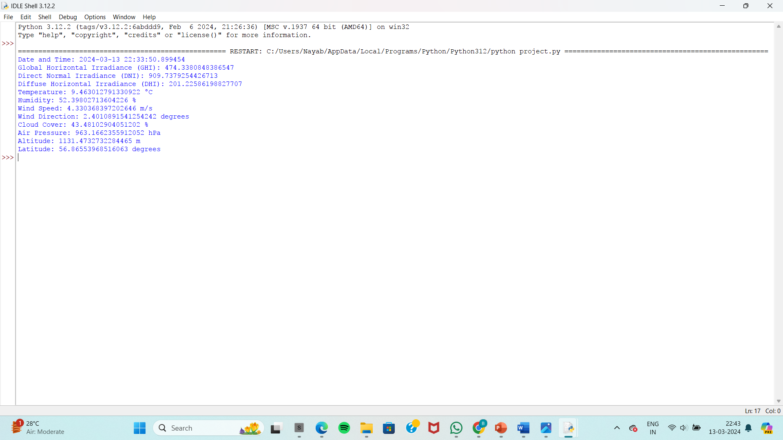
OUTPUT:

Slide 22
RESEARCH GAP:
Despite advancements in predicting solar radiation levels, several research gaps persist. One significant gap lies in the spatial resolution of current models, which often lack the granularity needed for site-specific assessments, particularly in urban environments with complex terrain. Additionally, accurate forecasting of cloud cover dynamics remains challenging, leading to uncertainties in solar radiation predictions. Long-term forecasting, especially for seasonal and interannual variations, is another area requiring attention, as it is crucial for energy system planning and climate adaptation. Moreover, the availability and quality of solar radiation data, especially in developing regions, present challenges for model development and validation. Incorporating data from emerging sources like satellite constellations and ground-based sensor networks requires novel integration methods.

Slide 23
Long-term forecasting, especially for seasonal and interannual variations, is another area requiring attention, as it is crucial for energy system planning and climate adaptation. Moreover, the availability and quality of solar radiation data, especially in developing regions, present challenges for model development and validation. Incorporating data from emerging sources like satellite constellations and ground-based sensor networks requires novel integration methods. Furthermore, there is a need for robust methodologies to quantify and propagate uncertainties in solar radiation predictions, as well as standardized validation frameworks to compare model performances effectively. Understanding the impacts of climate change on solar radiation patterns and addressing the influence of atmospheric aerosols are also areas ripe for further investigation.

Slide 24
Bridging the gap between solar radiation prediction and solar energy forecasting is crucial for improving the reliability of renewable energy systems. Interdisciplinary collaboration among meteorologists, climatologists, engineers, and data scientists is essential to address these multifaceted challenges comprehensively. Closing these research gaps will enhance the accuracy, reliability, and applicability of solar radiation prediction models, ultimately supporting the transition to a more sustainable and resilient energy future.

Slide 25
CONCLUSION:
In conclusion, predicting solar radiation levels is a vital endeavor with far-reaching implications for renewable energy, climate science, agriculture, and urban planning. Despite significant progress, there are still notable challenges and research gaps to address. Enhancing the spatial resolution of models, improving cloud cover forecasting, and incorporating emerging data sources are critical areas for advancement. Long-term forecasting and uncertainty quantification methods are essential for informed decision-making and climate adaptation strategies. Bridging the gap between solar radiation prediction and solar energy forecasting will further bolster the reliability and efficiency of renewable energy systems. Collaboration across disciplines and the standardization of validation frameworks are crucial for advancing the field. By addressing these challenges and gaps, we can improve the accuracy, reliability, and applicability of solar radiation prediction models, ultimately facilitating the transition to a more sustainable and resilient energy future.

Slide 26
REFERENCE:
Khanlari A, Sozen A, S ¸irin C, Tuncer AD, Gungor A. Performance enhancement of a greenhouse dryer. J Clean Prod 2020;251:119672.
Palani Sundarambal, , Shie-Yui Luong, Tallish Pavel. An ANN application for water quality forecasting. Mar Pollut Bull 2008;56(9):1586–97.
Balog I, Podrascanin Z, Spinelli F, Caputo G, Sivero R, Benedetti A. July). AIP Publishing LLC; 2019. p. 190004. No. 1.
Dong N, Chang JF, Wu AG, Gao ZK. Neural network framework based solar irradiance prediction 2020; 114:105411.
Weston Jason, et al. Deep learning via semi-supervised embedding. Berlin, Heidelberg: Springer; 2012. p. 639–55.

Slide 27
Feng Y, Gong D , Jiang S, Cui N. Empirical models for predicting daily solar radiation. Energy Convers Manag 2019;198:111780.
Jiang Y. Prediction solar radiation using artificial neural networks and comparison with empirical models. Energy Pol 2008;36 (10):3833–7.
Mabel M Carolin, Fernandez Eugene. Wind power generation- analysis and prediction using ANN: a case study. Renew Energy 2008;33(5):986–92.
Zeng H, Xu Q, Bian H. Generation of typical solar radiation data for different climates of globe. Energy 2012;38(1):236–48.
Mohammadi K, Shamshirband S, Anisi MH, Alam KA, Petkovi´c D. Vector regression prediction of solar radiation. 2015;91:433–41.

Slide 28


